Slide 1


Newton-Wellesley Hospital
6141530
Newton, MA
Annual Report
2018
Updated March 2019

Slide 2
Quality Measure Reports - Colon
ACT: Adjuvant chemotherapy for lymph node positive colon cancer (NQF 0223 – Accountability)
12RLN: At least 12 lymph nodes are removed and examined as part of primary colon cancer resection (NQF 0225 – Quality Improvement)
NQF = National Quality Forum Endorsed Measure

Slide 3
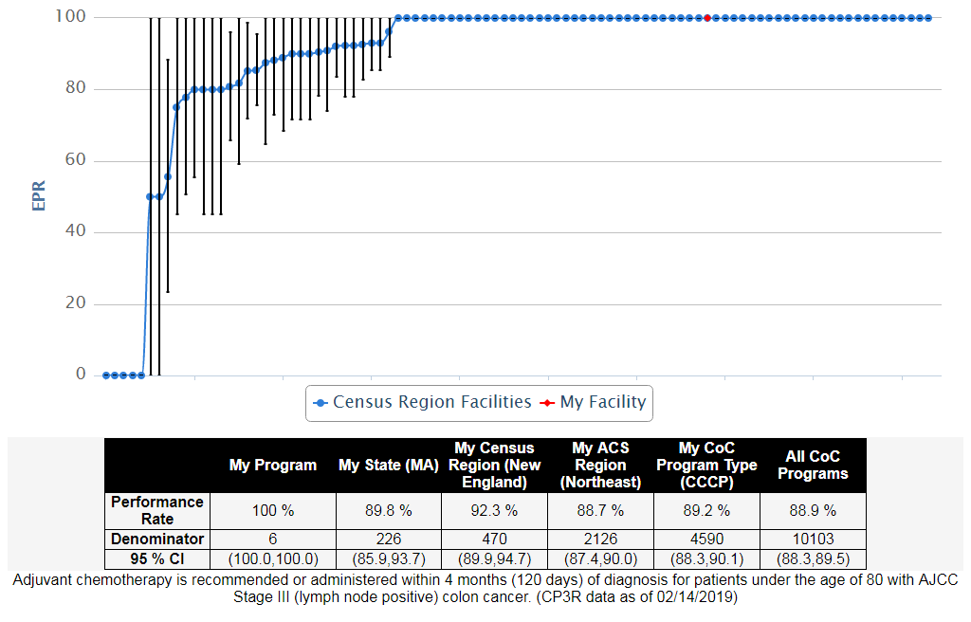
COLON, 2016, ACT: Adjuvant chemotherapy for lymph node positive colon cancer (NQF 0223 - Accountability)

Slide 4
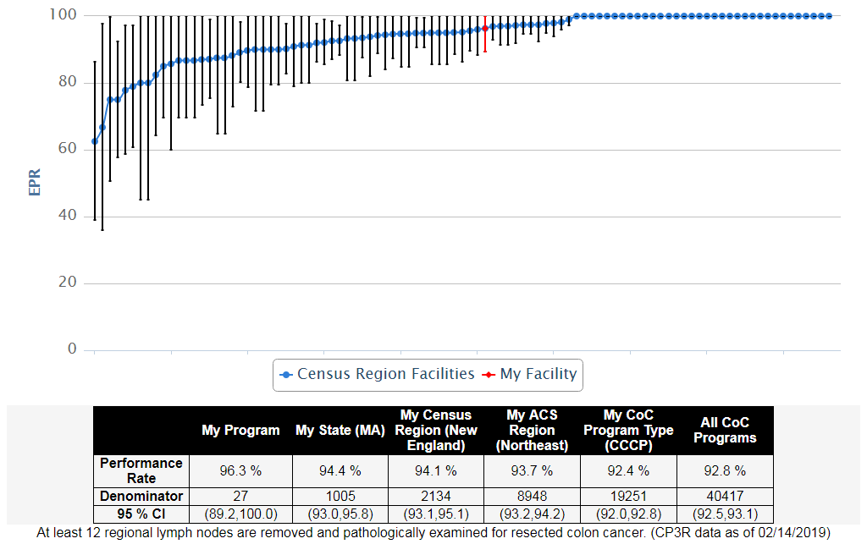
COLON, 2016, 12RL: At least 12 regional lymph nodes removed and pathologically examined for resected colon cancer (NQF 0225 - Quality Improvement)

Slide 5
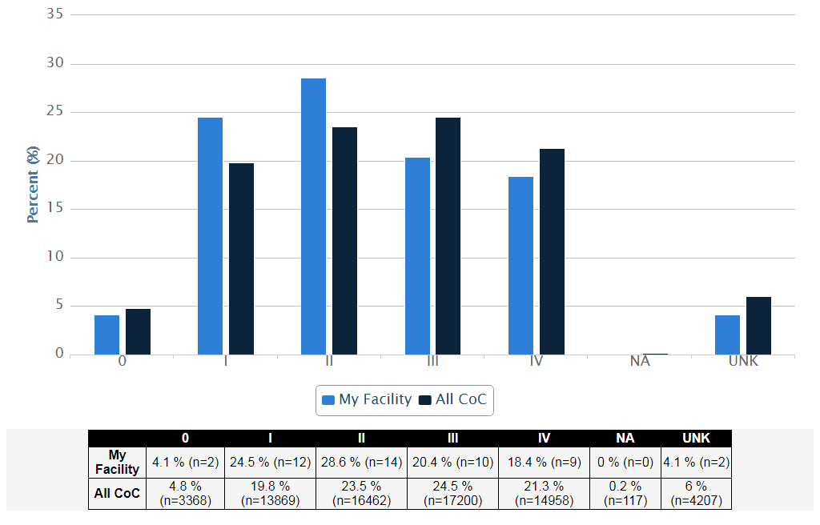
Stage Distribution - Colon Cancer Diagnosed in 2016, My Facility vs. All CoC

Slide 6
Commission on Cancer
www.facs.org/quality-programs/cancer/coc
312-202-5085
CQIP
www.facs.org/quality-programs/cancer/ncdb/qualitytools/cqip

