Slide 1


Newton-Wellesley Hospital
6141530
Newton, MA
Annual Report
2018
Updated March 2019

Slide 2
Quality Measure Reports – Breast
BCSRT: Breast radiation after breast conserving surgery (NQF 0219 – Accountability)
HT: Adjuvant hormonal therapy for hormone receptor positive breast cancer (NQF 0220 – Accountability)
BCS: Breast conserving surgery rate (Surveillance)
nBx: Image or palpation-guided needle biopsy (core or FNA) is performed for the diagnosis of breast cancer (Quality Improvement)
NQF = National Quality Forum Endorsed Measure

Slide 3
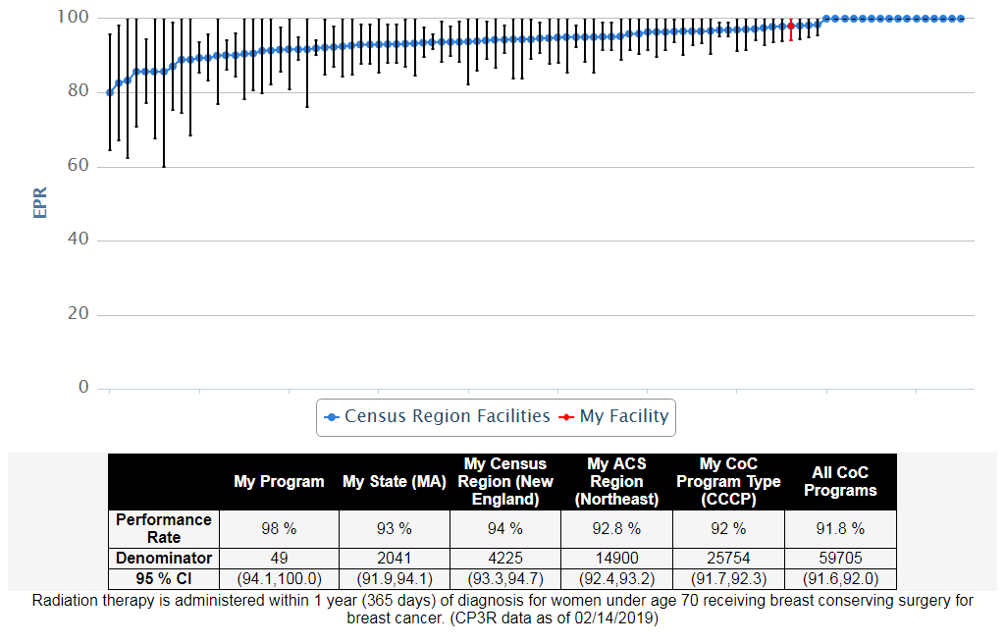
BREAST, 2016, BCSRT: Breast radiation after breast conserving surgery (NQF 0219 - Accountability)

Slide 4
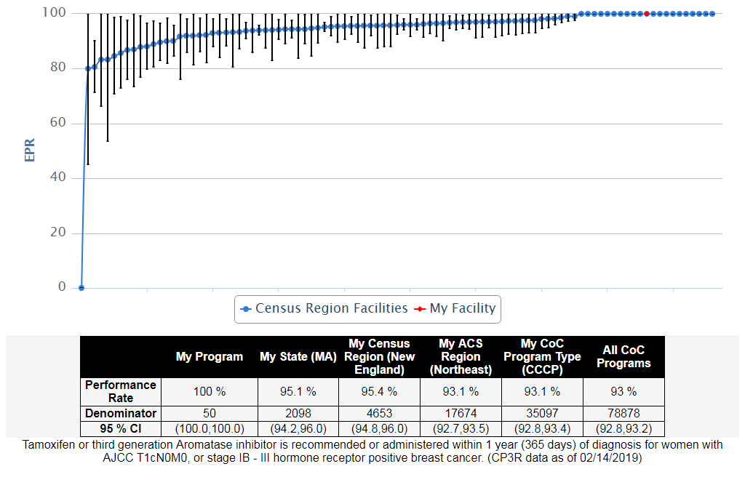
BREAST, 2016, HT: Adjuvant hormonal therapy for hormone receptor positive breast cancer (NQF 0220 - Accountability)

Slide 5
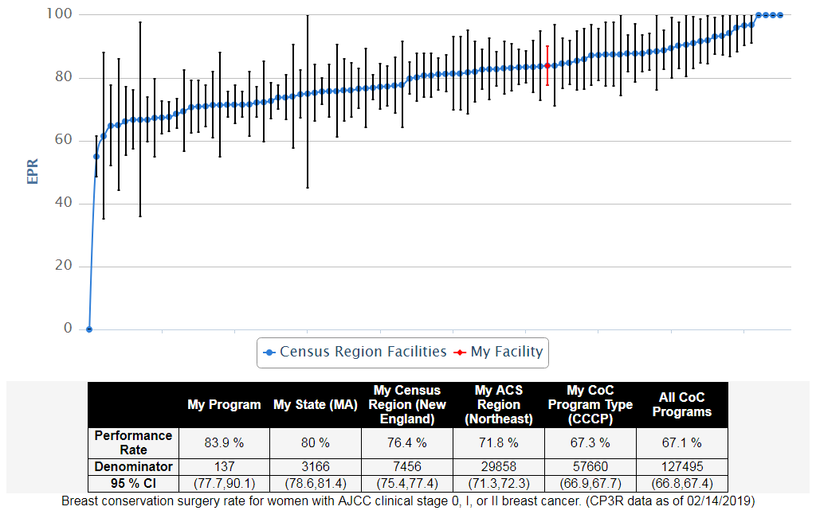
BREAST, 2016, BCS: Breast conserving surgery rate (Surveillance)

Slide 6
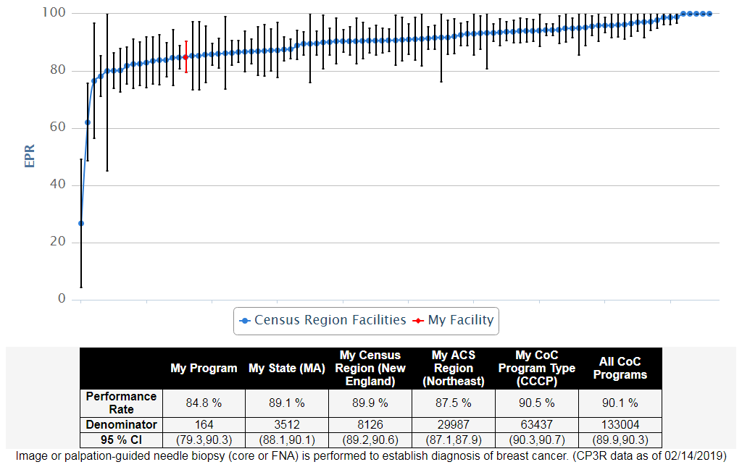
BREAST, 2016, nBx: Image or palpation-guided needle biopsy (core or FNA) is performed for the diagnosis of breast cancer (Quality Improvement)

Slide 7
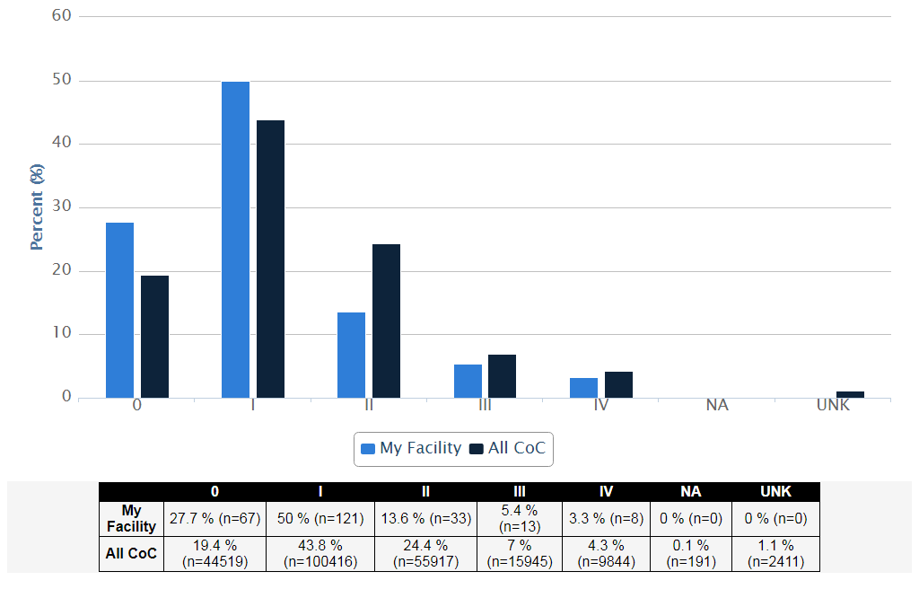
Stage Distribution - Breast Cancer Diagnosed in 2016, My Facility vs. All CoC

Slide 8
Commission on Cancer
www.facs.org/quality-programs/cancer/coc
312-202-5085
CQIP
www.facs.org/quality-programs/cancer/ncdb/qualitytools/cqip

